Slide 1



Satellite Deployment Trend Analysis
Domain Name : Data Analytics
Presented By :
Miss. Rajeshwari Handge
Mentor Name:
Mr. Chaitanya Dahale

Slide 2
Introduction
Satellites play a critical role in:
Communication , Navigation (GPS / NavIC)
Weather forecasting,National security
Scientific research,etc.
Every year, more satellites are launched globally,ISRO is emerging as a key global space player.
This project analyzes the Satellite Launches Globally.

Slide 3
Objectives
Primary Objectives:
Analyze launch vehicle usage (PSLV, GSLV, etc.)
Identify yearly and monthly launch trends.
Understand mission focus (communication, scientific, etc.)
Secondary Objectives:
Identify growth patterns.
Support future launch forecasting.
Present insights in a simple dashboard.

Slide 4
DATA DESCRIPTION
For both Global And ISRO’s Data:
Satellite Name , Launch Date
Launch Year , Launch Vehicle
Mission Purpose
Orbit Type (LEO / MEO / GEO)
Status (Successful / Unsuccessful)
Data standardized for accurate comparison

Slide 5
DATA CLEANING PROCESS
Removed unnecessary technical columns.
Extracted Year & Month from launch date.
Standardized values:
Orbit → LEO / MEO / GEO.
Purpose → Communication, Earth Observation, Scientific and Technology Development.
Handled missing and duplicate values.
Result: Clean, analysis-ready dataset.

Slide 6
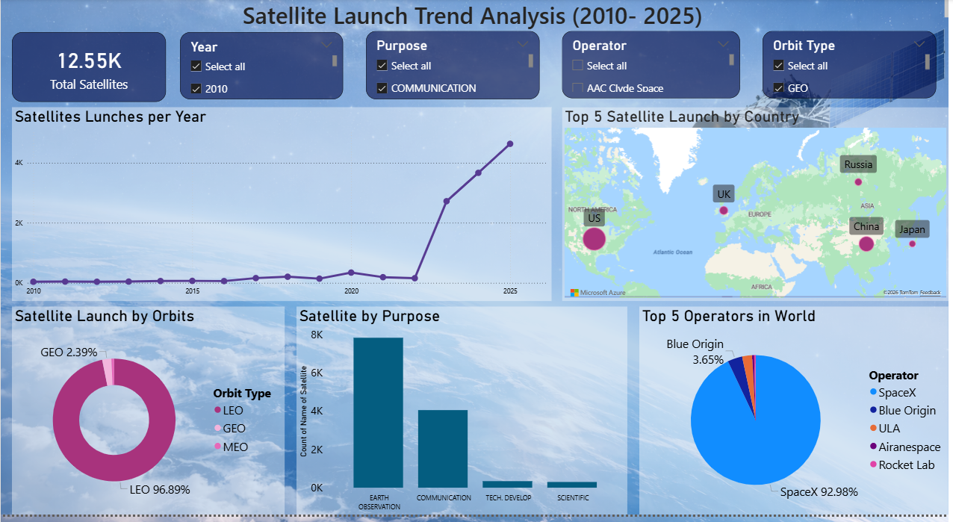
FINDINGS AND ANALYSIS

Slide 7
LIMITATIONS
The analysis is based only on historical satellite launch data.
The dashboard does not include real-time or live launch updates.
Limited mission-level details are available in the dataset.
Accuracy depends on the quality and completeness of the available data.

Slide 8
FUTURE SCOPE
Integrate real-time satellite launch data for live monitoring.
Use historical trends to support future launch planning and scheduling.
Apply predictive analytics to estimate upcoming launch trends.
Add deeper mission-level and satellite-level analysis.
Expand coverage to include more private and commercial space agencies.ilable data.

Slide 9
Conclusion
Global satellite launches show a consistent increase over the years, indicating rapid
growth in space activities worldwide.
Top operators contribute the majority of launches, showing strong leadership in the
space sector.
ISRO demonstrates a high mission success rate, reflecting reliability and efficiency in
satellite launches.
These insights support strategic analysis, policy planning, and performance
evaluation in the space domain.

Slide 10


